Slide 1
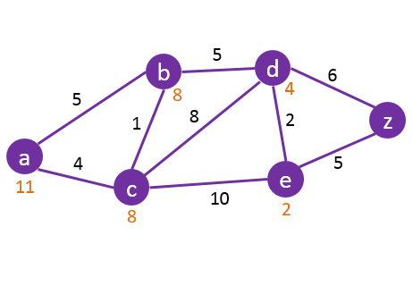
Real Life Applications of A* Search
Applications in Navigation, Games, and Robotics
Chime Nguyen & Adalynn Everly
April, 2026
Notes:
Slide 1 - Adalynn:
Hello my name is
Adalynn,
Chime: And my name is Chime
Adalynn:
And this is real life applications A* Search

Slide 2
Agenda
f(n) = g(n) + h(n)
g(n): path cost so far
h(n): estimated cost remaining
1 What Is A*?
2 Benefits and Limitations 3 A* In Map Navigation
4 A* In Game Development
5 A* In Robotics
6 Conclusion
Real Life Applications of A* Search
Agenda
Notes:
Slide 2 - Chime Nguyen
So for today’s Agenda, we will cover what is A* at a higher level and explain how A* works in more detail.
We will then cover the Benefits and Limitations of using A*, followed by three of A* most prominent applications where A* is widely useful, such as Map Navigation, Game Development, and Robotics, before finally wrapping up this presentation.
To the left is an example of how A* is used to search in a graph as well as the general equation for A*, more on that in a bit. (change slide)

Slide 3

What Is A*?
A* is a search algorithm used to find the shortest or lowest-cost path between points.
Why It Matters:
A* is widely used in navigation, games, and robotics because it is usually more efficient than uninformed search algorithms.
Real Life Applications of A* Search
What Is A*?
Notes:
Slide 3 - Adalynn
So What Is A*? A* is a search algorithm that is used to find the shortest or lowest cost path or solution between points.
A* matters in applications like map navigation, games, and robotics because it is usually more efficient than uninformed search algorithms such as Breadth-First Search, Depth-First Search, and Uniform Cost Search. In other words, A* is an informed search algorithm and it relies on an admissible heuristic that is tied to each application and domain to be optimal.
To explain How A* Works, I’ll pass it over to Chime.
(change slide)

Slide 4
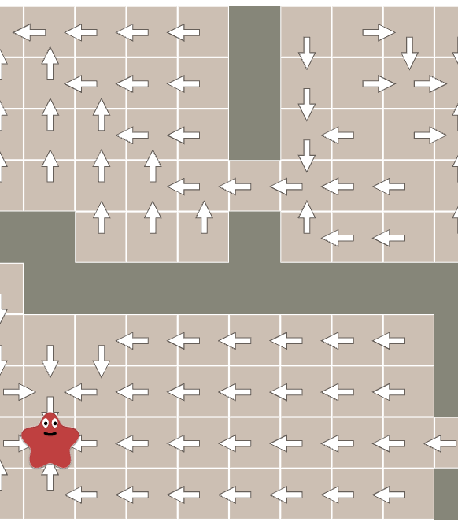
How A* Works
Formula: f(n) = g(n) + h(n)
g(n): cost so far
h(n): estimated cost to the goal
A* evaluates possible paths by combining the actual cost already traveled with an estimate of the cost remaining, then chooses the most promising path.
Real Life Applications of A* Search
What Is A*?
Notes:
Slide 4 - Chime
This slide shows the basic idea of how A* works. A* tries to find the best path from a starting point to a goal by combining two values. The first is g of n, which is the actual cost of the path so far, or how far you’ve already traveled. The second value is h of n, which is the estimated cost from the current position to the goal.
When we value add those together, we get f of n, which is the total estimated cost of taking that path. A* compares different possible paths and chooses the one that looks the most promising based on that tota valel.
So instead of checking every possible route equally, it uses both real cost and estimated remaining cost to guide the search more efficiently. That’s what makes A* faster and more practical than uninformed search methods in many cases.
Passing over to Adalynn.
(change slide)

Slide 5
Benefits
Finds optimal paths with
a good heuristic
More efficient than
uninformed search
Widely applicable in
maps, games, and robotics
Real Life Applications of A* Search
Benefits and Limitations
Notes:
Slide 5 - Adalynn
A benefit of using A* includes the ability to Find Optimal Paths With A Good Heuristic, which in turn makes A* More Efficient Than Uninformed Search. What classifies as a good heuristic is one that is admissible, in other words, one that will never overestimate the cost of any path, or one that is consistent, meaning that for every node, the cost of the heuristic is less than the cost of said node to its successor due to an action plus the heuristic of the successor node.
This means that A* is beneficial for problems that require traversing, which is why it is Widely Applicable in Maps, Games, And Robotics.
(change slide)

Slide 6
Limitations
High memory usage
Performance depends on
a good heuristic
Less effective in
dynamic environments
Real Life Applications of A* Search
Benefits and Limitations
Notes:
Slide 6 - Chime
Some limitations of A* includes High Memory Usage, the Performance is Dependent On A Good Heuristic, and that A* is Less Effective In Dynamic Environments.
For High Memory Usage, this applies to much larger and harder problem spaces or with systems with low memory. It is possible that either the number of nodes that has to be expanded can become exponential. It is also possible that when it runs out of available memory, some subtrees may be removed only to be later revisited again since it has lost the information from said subtrees.
As I’ve alluded to earlier, it requires a good heuristic in order to be optimal, but what if the heuristic is sub-optimal or not even a good for the domain problem? Then we would run into an issue where a sub-optimal heuristic would produce a sub-optimal solution where the final cost of A* with the sub-optimal heuristic would be greater than one with an optimal heuristic.
As with Dynamic Environments, if multiple variables were to be changed or updated as time goes on, A* would have to run again and again in order to have accurate information on the environment, making A* costly to run frequently.
(change slide)

Slide 7
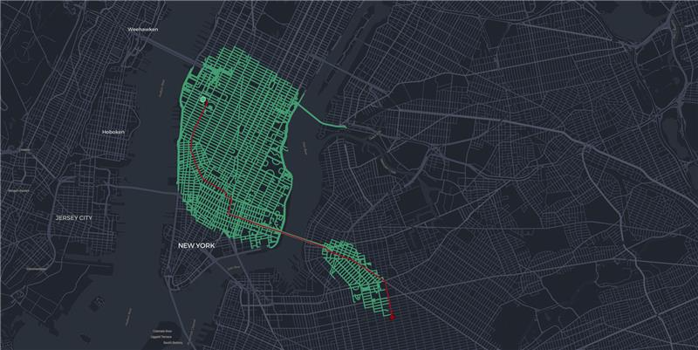
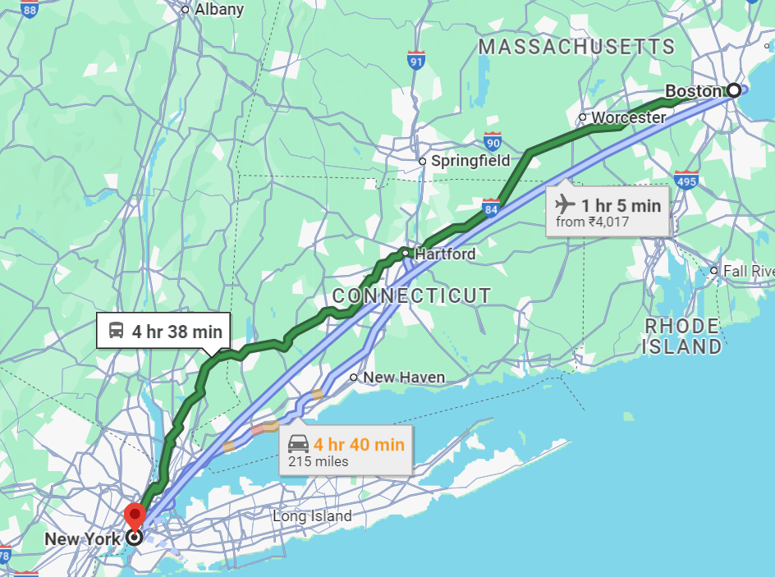
A* In Map
Navigation
A* is used in map navigation to find efficient routes between a starting point and a destination.
It works by combining:
the distance already traveled
an estimate of the remaining distance
In practice, this helps navigation systems:
find shorter routes faster
avoid checking every possible path
respond efficiently in large road networks
Real Life Applications of A* Search
A* In Map Navigation
Notes:
Slide 7 - Adalynn:
One real-world use of A* is map navigation. The main goal here is to find an efficient route from a starting point to a destination without checking every possible road.
This is where A* is useful, because it combines two things: the distance already traveled, and an estimate of the distance still left to the destination. That lets it focus on routes that are more likely to be efficient instead of exploring everything blindly.
In systems like GPS or digital maps, that matters because road networks are huge. There may be thousands of possible paths, especially in cities. A* helps narrow those down and prioritize the routes that look the most promising.
So in practice, it can help a navigation system find shorter routes faster, reduce unnecessary searching, and work more efficiently on large-scale maps. That’s why A* is a strong fit for route planning and navigation problems.
(change slide)

Slide 8
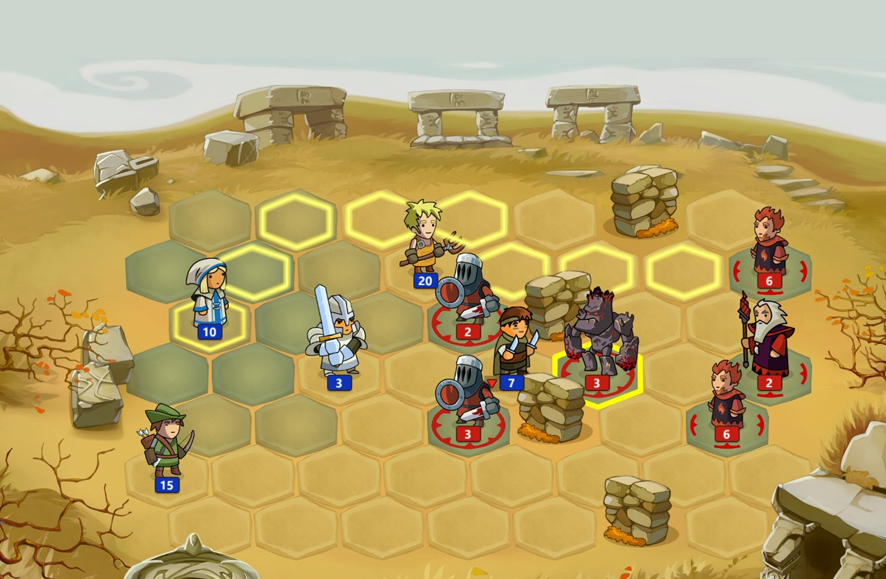
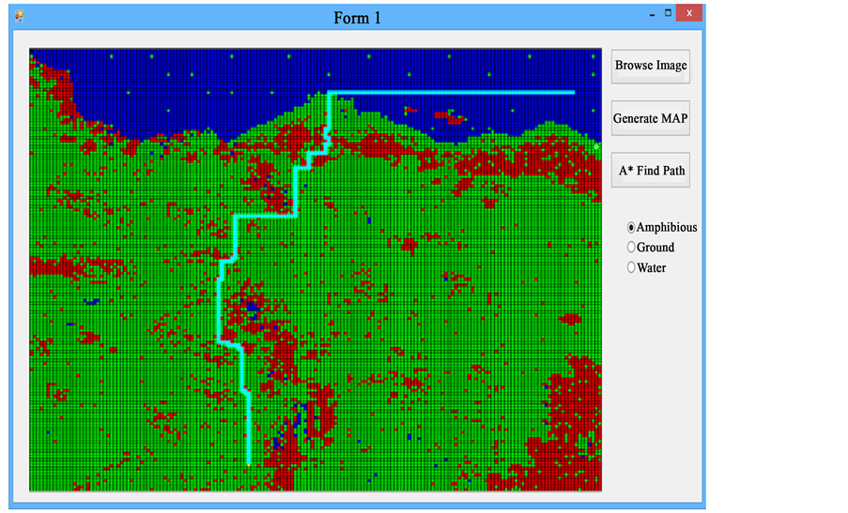
A* In Game
Development
A* is widely used in video games for pathfinding.
It helps non-playable characters (NPCs):
move toward goals efficiently
navigate around walls or obstacles
choose routes in real time
This makes game movement look more intelligent and realistic.
Real Life Applications of A* Search
A* In Game Development
Notes:
Slide 8 - Chime:
Another major application of A* is in game development, especially for pathfinding. In a lot of games, non-playable characters, or NPCs, needs to move from one location to another in a way that looks smart and realistic.
Instead of just moving in a straight line and getting stuck on walls or obstacles, A* helps the game calculate a path that actually works within the map boundraries. It does that by choosing routes that seem efficient while still accounting for the layout of the environment.
This is useful in games because movement often has to happen in real time. Enemies, teammates, or other units need to react quickly and navigate around terrain, walls, or blocked areas.
For example, in strategy games like StarCraft, units often need to move across the map while avoiding terrain, structures, and other obstacles, while still reaching the target efficiently. A* helps make those movements look more intelligent instead of random or inefficient.
So overall, A* helps NPCs move toward goals more efficiently, avoid obstacles, and make game behavior look more intelligent. That’s why pathfinding is one of the most common uses of A* in video games.
(change slide)

Slide 9
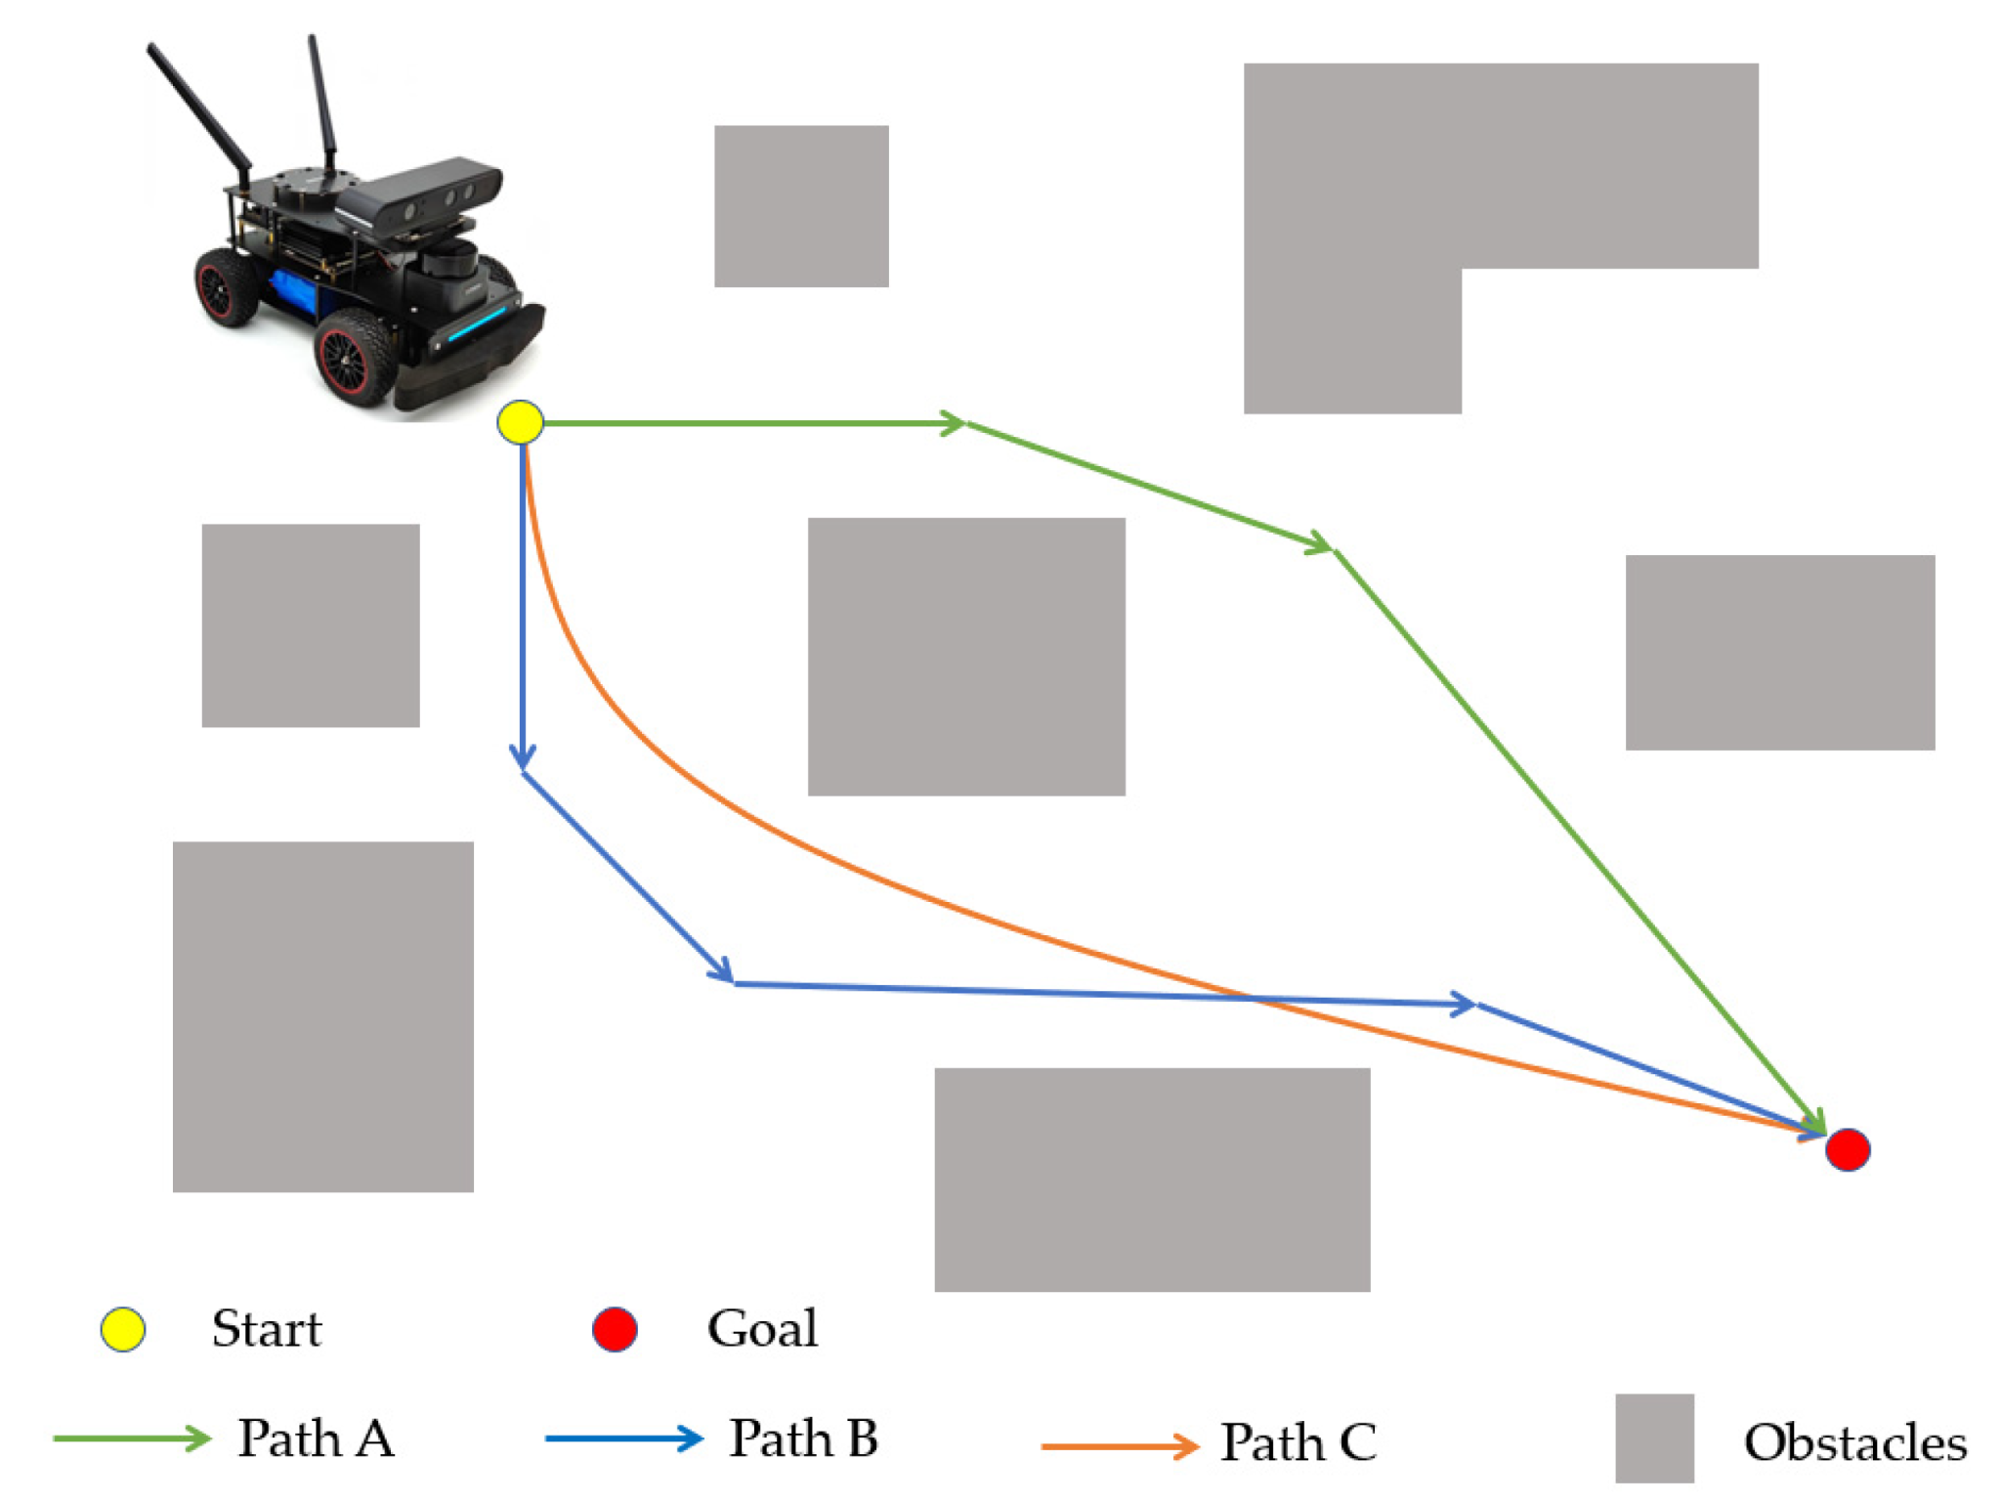
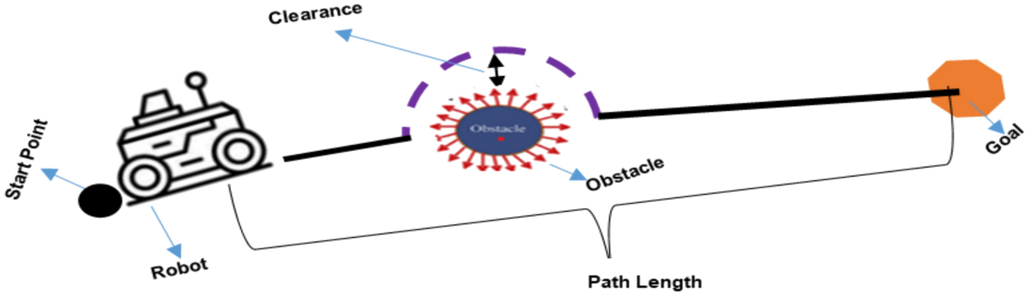
A* In Robotics
A* is used in robotics for path planning and navigation.
It helps robots:
find efficient routes from start to goal
avoid obstacles in the environment
move safely in warehouses, factories, and autonomous systems
This improves efficiency, safety, and reliability.
Real Life Applications of A* Search
A* In Robotics
Notes:
Slide 9 - Adalynn:
Another important real-world use of A* is in robotics. In this case, the main problem is path planning, which means figuring out how a robot can move from a starting point to a goal safely and efficiently.
This is useful because robots usually operate in environments with obstacles, so they cannot just move in a straight line. They have to find a route that actually works while still keeping the movement efficient.
A* helps with that by evaluating possible paths and choosing one that balances the cost so far with an estimate of the remaining cost to the destination. In other words, it helps the robot make smarter movement decisions instead of just exploring blindly.
In practice, this matters in places like warehouses, factories, and autonomous systems, where robots need to move around objects, avoid collisions, and still reach their target reliably.
So overall, A* improves efficiency, safety, and reliability, which is why it is such a useful algorithm for robotic navigation.

Slide 10
Conclusion
A* is a powerful pathfinding algorithm used in real-world AI applications.
It is especially useful in map navigation, game development, and robotics.
Its effectiveness comes from balancing path cost with estimated distance to the goal.
Although it has limitations, it remains one of the most practical search algorithms in AI.
Real Life Applications of A* Search
Conclusion
Notes:
Slide 10 - Chime
To recap, A* is a powerful pathfinding algorithm that is used in real-world applications where you navigate from one destination to another on a map, allow for NPCs and enemies to traverse effectively, and make robots maneuver around blocked routes.
It all stems from trying to balance the path cost with the estimated distance to the goal, and although it has some limitations, it is a practical search algorithm that is still used in AI today.
(change slide)
Slide 11 - Chime
Thank You
(change slide)
Slide 12 - Chime
And these are our references. Any questions?

Slide 11

Thank You

Slide 12
References
Russell, S. J., & Norvig, P. (2021). Artificial Intelligence: a Modern Approach (4th ed.). Pearson.
Russell, S., & Norvig, P. (2022, August 22). Artificial Intelligence: A Modern Approach, 4th US ed. Aima.cs.berkeley.edu. https://aima.cs.berkeley.edu/
Kabir R, Watanobe Y, Islam MR, Naruse K. Enhanced Robot Motion Block of A-Star Algorithm for Robotic Path Planning. Sensors. 2024; 24(5):1422. https://doi.org/10.3390/s24051422
Hart, P., Nilsson, N., & Raphael, B. (1968). A Formal Basis for the Heuristic Determination of Minimum Cost Paths. IEEE Transactions on Systems Science and Cybernetics, 4(2), 100–107. https://doi.org/10.1109/
tssc.1968.300136
Cui, X., & Shi, H. (2010, November). (PDF) A*-based Pathfinding in Modern Computer Games. ResearchGate. https://www.researchgate.net/
publication/267809499_A-based_Pathfinding_in_Modern_Computer_Games
Red Blob Games. (2014). Red Blob Games: Introduction to A*. Redblobgames.com. https://www.redblobgames.com/
pathfinding/a-star/introduction.html
Welcome To Zscaler Directory Authentication. (2026). Geowgs84.Ai. https://www.geowgs84.ai/post/
what-is-the-a-a-star-algorithm
Real Life Applications of A* Search
References

